Slide 1
12
The Design of the Tax System

Slide 2

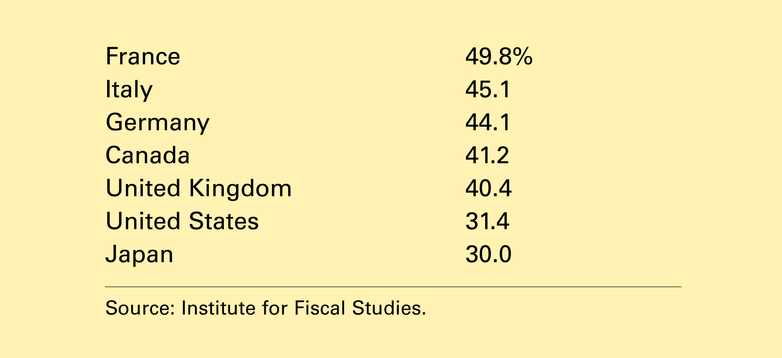
Table 1 Central Government Tax Revenue as a Percent of GDP
Copyright©2004 South-Western

Slide 3
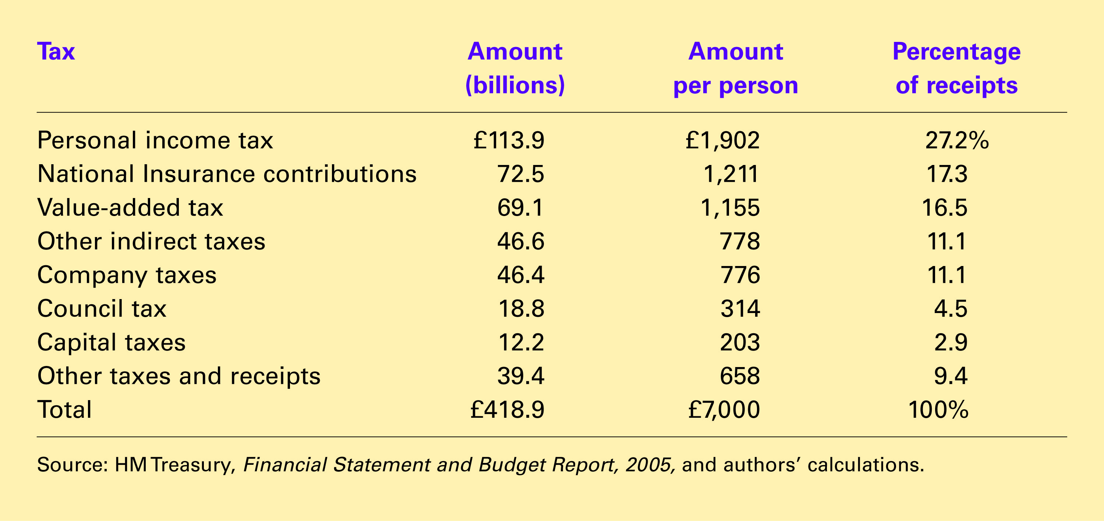
Table 2 Sources of UK Government Revenue: 2003-04
Copyright©2004 South-Western

Slide 4
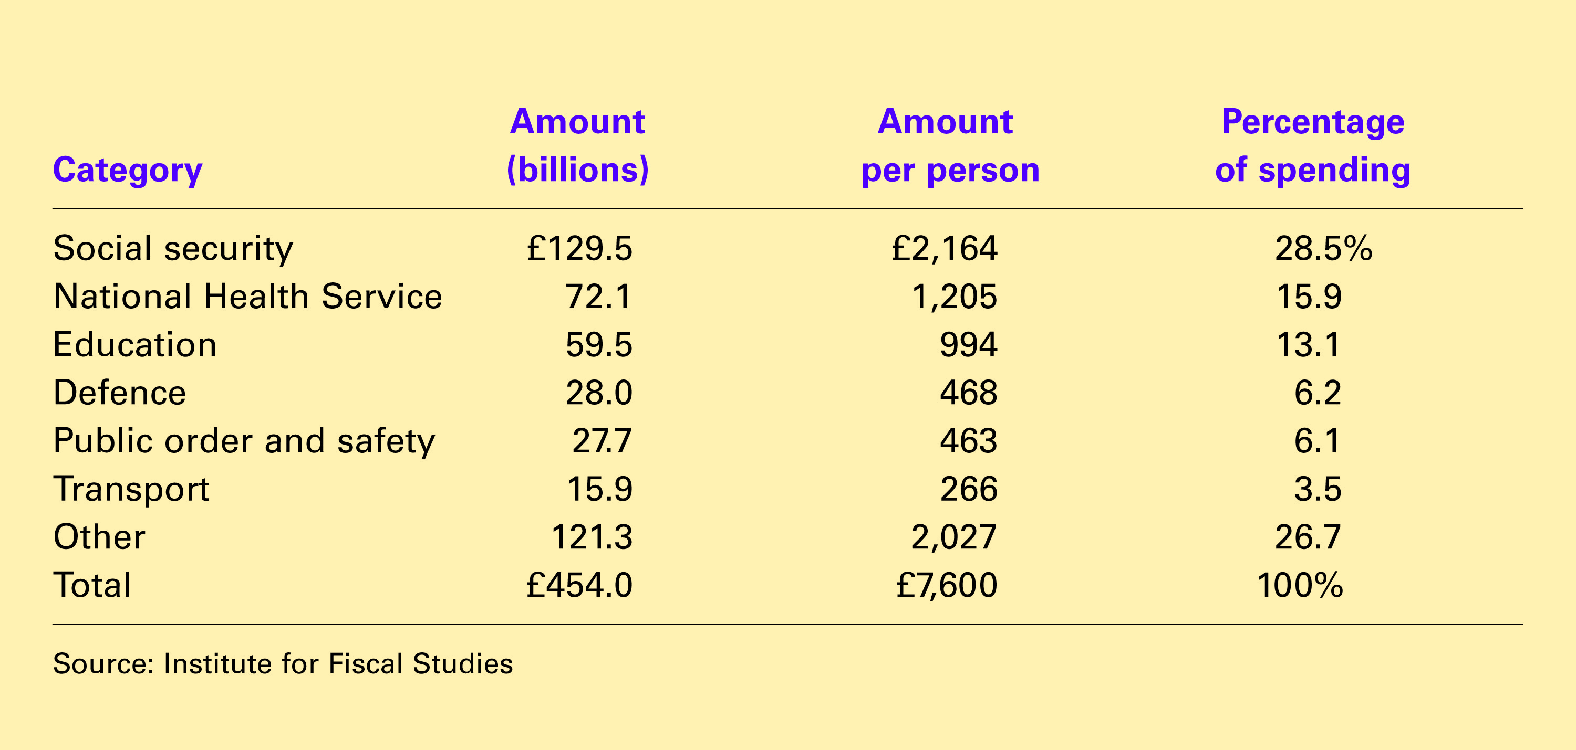
Table 4 UK Government Spending: 2003-04
Copyright©2004 South-Western

Slide 5
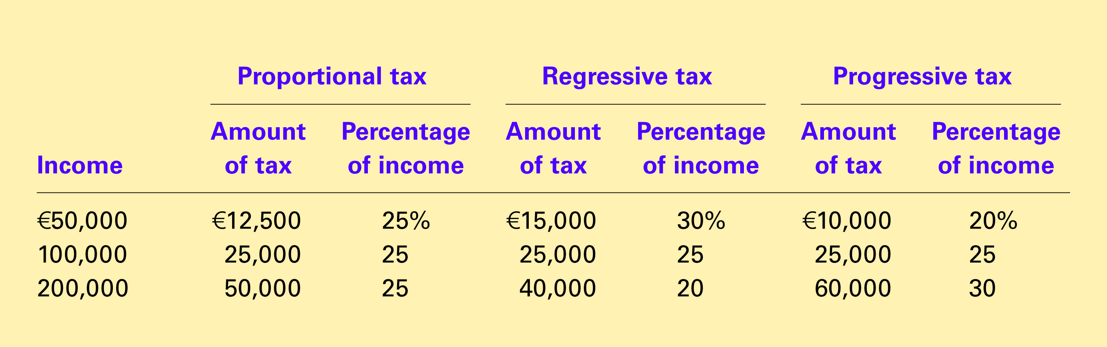
Table 7 Three Tax Systems
Copyright©2004 South-Western

Slide 6
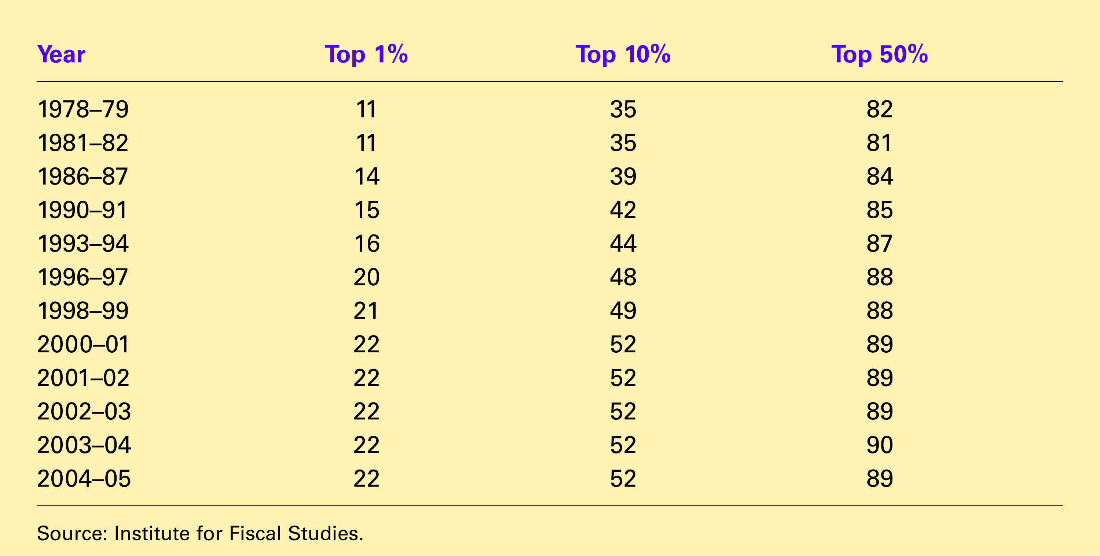
Table 8 Shares of Total UK Income Tax Paid By Groups Ranked According to Income
Copyright©2004 South-Western

